Slide 1
Asia Regional Dialogue on Climate Justice
Through Indigenous Peoples Lens
Sharing Experiences of being and working as defenders

Slide 2
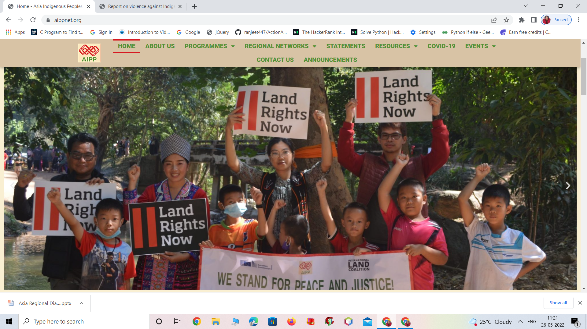
WHY IP and land rights?
  For indigenous peoples, the land associates beyond monetary value.
Their land which often is ancestral, associates with their lifestyle and livelihood
Associates with their culture and
associates with their overall identity.

Slide 3
KHOKANA road expansion: case of Nepal
forced migration- displacement of IP and local community
Khokana already is witnessing the impacts of climate change and pollution.
State plans to expand the road, fast track is to be built through the community’s land and settlement area.
encroachment will directly affect their socio-cultural identity and extinction of culture, livelihood and existence- HISTORY!

Slide 4
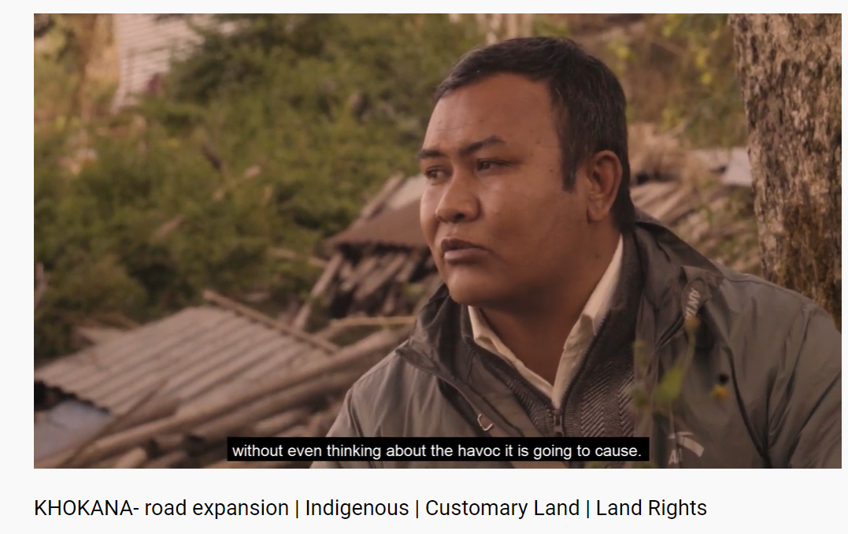
The inhabitants of Khokana believe in co-existing with nature and harnessing the land for sustainable living which they have been doing for generations.
Significance: Festivals, lifestyle and culture revolve in and around the rivers and lands.
Displacement- compensate the landowners and to use military forces to have engulfed fears among the locals of Khokana of losing their identity and displacement from their ancestral lands.

Slide 5
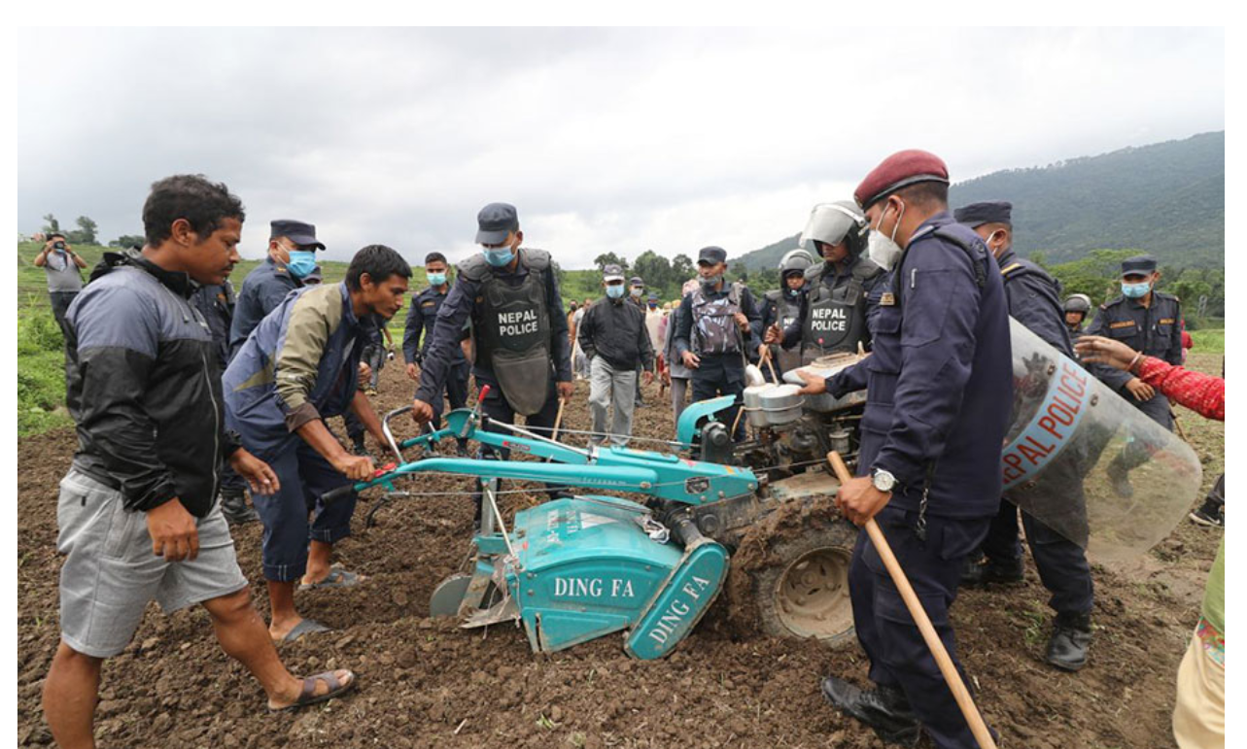
Police personnel try to snatch away a tractor from locals of Khokana, June 29, 2020.
Photo courtesy: Online khabar

Slide 6
Challenges faced by IP activists
Militarization and violence against human rights defenders- Military forces- Pressure/Stress- fear- affects mental health
Physical violence against HRD – arrested and detained
Face trumped up charges- harassment –phy and mentally
It is estimated that 40 to 50 percent of the environmental defenders who are killed are Indigenous persons predominantly from Asia.
The IPs’ right allegedly manipulated to serve the interest of corporations
Threats to life: HRD lose their lives.
Politicised: removed from jobs

Slide 7
Strategies for risk mitigation - Safeguards
Build and strengthen our capacities – rights and safeguards
The ILO convention 169 Article 7 clearly states that ‘The peoples concerned shall have the right to decide their own priorities for the process of development as it affects their lives, beliefs, institutions and spiritual well-being and the lands they occupy or otherwise use, and to exercise control, to the extent possible, over their own economic, social and cultural development.’
The CBD is relevant to Indigenous Peoples because it recognizes the dependence of many Indigenous Peoples and local communities on biological resources and acknowledges the contribution of traditional knowledge for both conservation and sustainable use of biological diversity. In recognizing Indigenous Peoples and their traditional knowledge as key components in the pursuit of the CBD objectives.
UNDRIP
FPIC
CEDAW

Slide 8
Awareness programs/campaigns – IPs and non-IPs
Stop criminalization of Indigenous lifestyles, food systems, and culture.
Ensure that climate change and disaster risk reduction measures are gender responsive, sensitive to Indigenous knowledge systems, and adhere to the rights of Indigenous Peoples
Stop violating and manipulating the rights of Indigenous women and girls in the name of development, political process, or emergency measures (e.g. pandemic).
Ensure proper implementation UNDRIP, CEDAW
Ensure meaningful opportunities for Indigenous women to participate in political decision making and development planning (CEDAW articles 7, 8 and 14), FPIC
Advocacy and lobby (national and intl forum) – consistency – concrete and legal work plan in support of lawyers (collective effort).

Slide 9
Lastly,
For how long does the indigenous population need to fight for their legal rights with the state?

