Slide 1
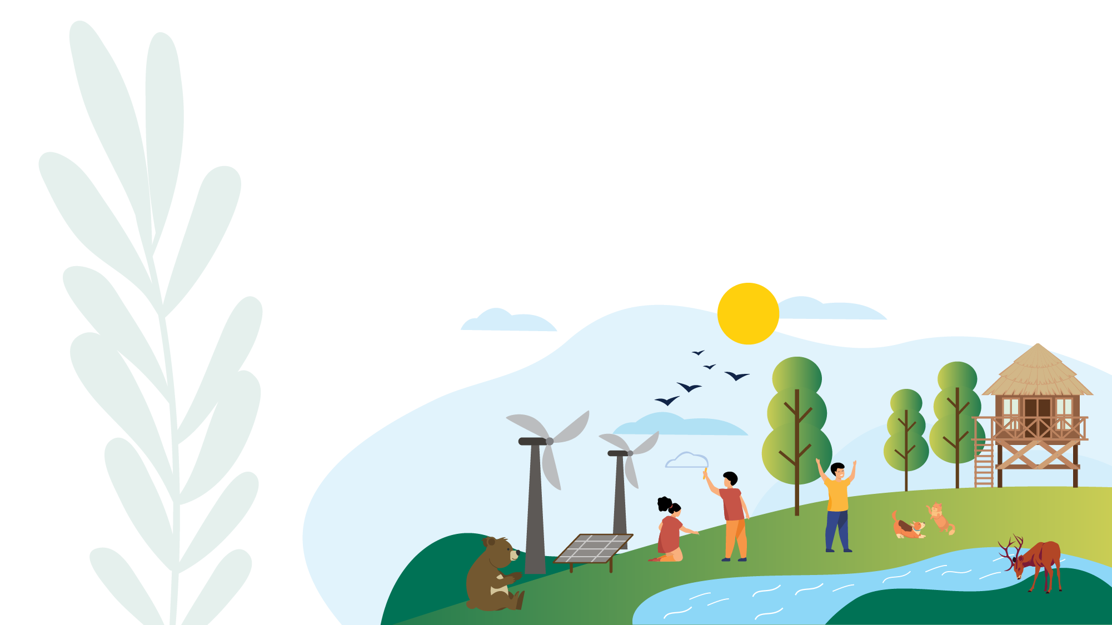
Legal Empowerment to Advance Climate and Environmental Justice for Children in East Asia and the Pacific
Notes:
This UNICEF project was carried out over the past year and has just concluded with capacity-building workshops in Indonesia and Malaysia.

Slide 2
What is legal empowerment?
Legal empowerment is about how children and young people can take steps by themselves, and sometimes with the support of adults, to fully enjoy their rights to a healthy environment, including a safe climate.
It can involve using the law or taking other action that does not involve the law.
Notes:
You will see from the case studies that legal empowerment of children for climate and environmental justice has many different aspects.

Slide 3
What was the project about?
East Asia and the Pacific
Legal empowerment to advance children’s climate and environmental justice
8 case studies
Challenges, lessons and opportunities
2 workshops
Child-Friendly Guidance for Legal Empowerment
Guidance for Legal Empowerment
Notes:
UNICEF’s regional office for East Asia and the Pacific carried out this project. It did not include South Asia, which is covered by a different UNICEF regional office.
The research and analysis was carried out by a team of lawyersin the Sydney, Australia office of King & Wood Mallesons, which is an international law firm.

Slide 4
AUSTRALIA Sharma v Minister for the Environment | GLOBAL Communication to the United Nations Committee on the Rights of the Child | INDONESIA Bye Bye Plastic Bags | MALAYSIA Klima Action Malaysia
A group of children brought a lawsuit in Australia and claimed that the Minister for the Environment owes Australian children a duty of care when deciding whether to approve the expansion of a coal mining project. The Court found that the Minister did owe a duty of care to children when making a decision about expanding the coal mining project. The Minister successfully challenged the decision through a legal appeals process. The children are considering their next steps. | A group of children made a complaint that 5 countries had violated their rights by contributing to climate change. The Committee decided that the countries do have control over the emissions that contribute to the harm to children, even if outside their territory, and also that there was a link between the harm and the actions of their governments. However, the Committee was not able to make a final decision, because you must try all legal solutions in the country you live in before applying to this Committee. | Two sisters in Bali started a movement against using single-use plastic. Bye Bye Plastic Bags create educational materials and workshops to teach people about plastic and pollution. Several cities in Indonesia have banned single-use plastics or plastic bags, as a result of the work of organisations like Bye Bye Plastic Bags. Bye Bye Plastic Bags are now creating an online platform called YOUTHTOPIA, which will provide training and workshops for young people interested in climate action. | Klima Action Malaysia is a climate activist group run by young people. It is focused on building partnerships with civil society organisations and vulnerable communities such as women, indigenous people and young people, to support climate action. They have organised climate strikes in Malaysia and worked with young people in other countries to plan the Asia Climate Rally in 2020. The group writes letters to parliament and succeeded in convincing their government to protect local forests.
Notes:
Here you get an idea of the variety of ways that legal empowerment of children for environmental and climate and justice can work.
One of these case studies was about a court case in Australia, brought by children supported by an adult.
Another was a complaint that children made to the global Committee on the Rights of the Child.
In Indonesia, two young sisters started a movement on the island where they live that has influenced other cities and is starting a web portal.
In Malaysia, a climate activist group run by young people is having an impact in Malaysia and works with similar groups in other countries as well.

Slide 5
MONGOLIA Air pollution mapping project | PHILIPPINES Minors Oposa v Factoran | THAILAND Klity Creek litigation | VANUATU International Court of Justice Advisory Opinion
YouCAN is a “Youth for Clean Air” programme started by UNICEF, the Scout Association of Mongolia (Mongolyn Skautyn Kholboo) and the Mongolian Government. The programme supports young people to conduct air quality monitoring and share information to reduce the risks of air pollution in Mongolia. YouCAN also provides training to young people to help them understand air pollution data. It also acts as a youth platform for advocacy on climate change issues. YouCAN supports a ‘Teen Parliament’ which engages with the Mongolian Parliament. | This was a lawsuit to prevent the destruction of rainforests. The claim was based on the Constitution of the Philippines, which says there is a right to a “balanced and healthful ecology in accord with the rhythm and harmony of nature”. The Court said that this environmental right is fundamental and that every generation has a responsibility to future generations. This case was the first in the world to recognise the rights of children to a healthy environment. | Villagers in Lower Klity Village brought 2 lawsuits against the Department of Pollution Control and a lead company, for pollution of a local waterway. The Supreme Court decided that the villagers’ rights to benefit from nature, and their rights to living in a healthy environment, had been violated. The Supreme Court decided that the lead company owed money to the villagers and that the government failed to stop pollution that caused harm. The children involved also advocate at the Mekong Youth Assembly. | Pacific Islands Students Fighting Climate Change is a student organisation. They are campaigning for a global court (called the International Court of Justice) to give an Advisory Opinion that will decide a legal question about climate change and the human rights of present and future generations. An Advisory Opinion would provide an important legal basis for action on climate change around the world, including as information for legal cases in international and domestic courts. The group includes young people from different countries, including law students.
Notes:
In these four case studies, there are two court cases – in Philippines and Thailand.
A student group in Vanuatu, with the support of the government, has asked the International Court of Justice to give an advisory opinion about climate change on an issue related to the human rights of present and future generations.
In Mongolia, a Scouting organization with the support of the government is getting young people involved in monitoring air quality.

Slide 6
steps to legal empowerment
Education
Expression
remedy
safety
Education about the legal system, and children’s rights to a healthy environment.
Free expression of views on climate change and environmental issues.
Access to legal and non-legal solutions to climate change and environmental issues.
Safe, child-friendly environment to take action on climate and environmental justice.
Notes:
The study identified four steps to legal empowerment.
Learning about…
Various ways to convey views...
Both access to...
Ensure children are protected, through...

Slide 7
Resources/funding
What challenges DO young people Face?
Education
Technology
Risks
Cyber bullying
Risk of harm
Going to court is hard
Notes:
The study found four challenges that were common to most or all of the case studies.
Funding is always a challenge.
Education for children and young people needs to include a focus on their rights to a healthy environment and safe climate.
Also, part of the education challenge is the fact that most adults have not been educated about children’s rights to a healthy environment and safe climate.
Access to the internet and to phones, tablets, and computers is a big challenge for children and young people in many countries.
There are risks.

Slide 8
Lessons
#1 Social media can support legal empowerment of children for environmental and climate justice
#2 Lawyers and other people with legal skills can support legal empowerment of children for environmental and climate justice
#3 Youth can support the empowerment of other youth
#4 Adults don’t need a law degree to empower youth
#5 Governments can be champions for children’s rights
Notes:
#1 – In all of the case studies, with the exception of the court case in Philippines which was decided before social media was so influential, children and young people are using social media to make their voices heard.
#2 – lawyers have supported children and young people in all of the court cases and in the complaints made to international bodies.
#3 – the cases in Indonesia and Malaysia are examples of how young people in Asia are networking with young climate activists in other parts of the world.
#4 – the person who suppprted the children who brought the court case in Australia was an 86-year-old nun.
#5 – the governments of Vanuatu and Mongolia are supporting young activists.

Slide 9
Opportunities for children, young people and caregivers
Education | Voice | Remedy | Safety
Learn: about what action has been taken around the world on climate change and environmental issues. about your legal system. Connect: with youth organisations, social media and community groups involved in climate and environmental justice causes. Educate and Share: young people with access to legal education and training can share their knowledge and experience with their communities. schools and teachers can support learning about climate change, environmental degradation, climate and environmental rights and the legal system. | Share: what you have learned about climate change, environmental degradation, your rights and your legal system. your views, your experiences and what action you can take on climate and environmental issues. | Consider: all solutions (not just legal solutions) that are available if a child’s climate or environmental rights are not respected. how you can support or act on behalf of children and young people in legal processes. | Support: children to be safe when sharing and advocating online.
Notes:
Here are some of the opportunities for children, young people and caregivers to learn, connect and educate on climate justice, share experiences regarding rights, legal systems, and action taken on climate and environmental issues, rights to remedy particularly in legal processes and support for protection of safe environment for online advocacy and involvement.
Hope these are some of the things that can get you started in terms of legal empowerment on climate justice. Without further ado, let’s hear more from our youth speakers, over back to the moderator. Thank you.
---
I would like to shine a spotlight to the two youth speakers that we have with us today, to share their experience participating in the Legal Empowerment Workshop.
Yu Cheng and Sri, do enlighten us on:
What are your key takeaways from the workshop?
What do you think children/youth your age can do to make sure that there is climate justice for you?
What is your message to the adults who will be deciding the future of this planet?
I’d like to invite Yu Cheng to share first, over to you.
That was very insightful and important messages indeed. Sri, do share your thoughts, we would love to hear from you.
Closing note:
Thank you for sharing. That brings us to the end of the session. While children face vulnerabilities and barriers in accessing justice, including climate and environmental justice, they are significant in the involvement of advancing more equitable, safe and just future. Thus, it is important for us to provide them with the space and tools to assist them in taking climate action. Thank you everyone for tuning in, back to you organisers.

