Slide 1

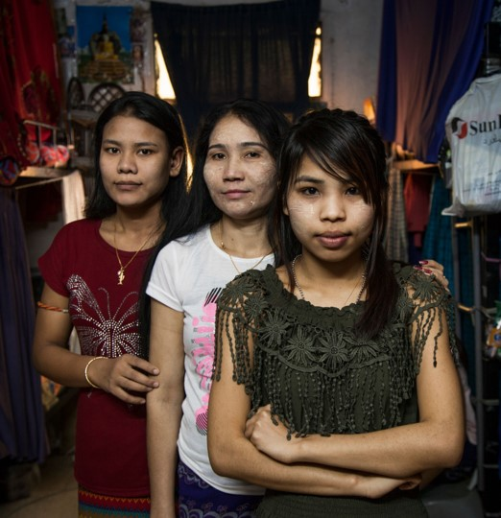


Public attitudes towards migrant workers in Japan, Malaysia, Singapore, and Thailand
Safe and Fair
and
TRIANGLE in ASEAN Programmes
Supported by:

Slide 2
Study Scope
Examine public attitudes in 4 countries of destination for ASEAN migrants, including Japan (which is increasingly opening for labour migration)
Compare public attitudes to ILO’s 2010 study in Malaysia, Singapore and Thailand

Slide 3
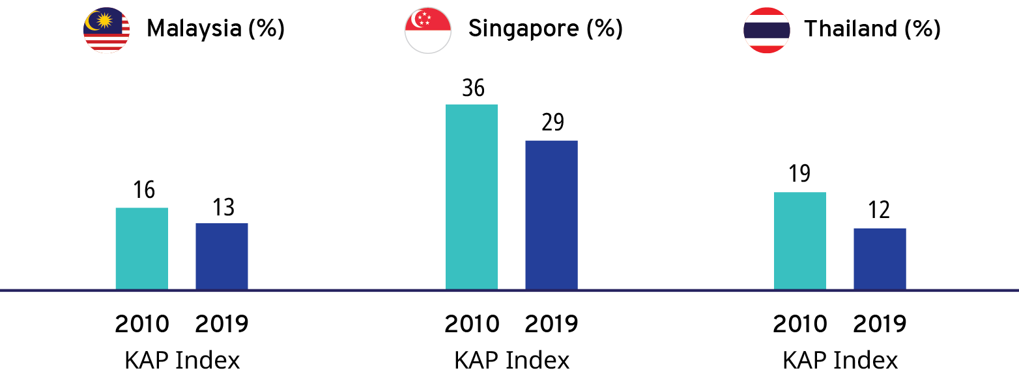
Overall Drop in Public Support since 2010
Notes:
While the research did not determine why attitudes towards migrant workers are declining, it does demonstrate that we are not successfully countering racism, xenophobia and hate. We need to find ways for people to understand how much the ASEAN region needs migrant workers, in both countries of origin and in destination.’

Slide 4
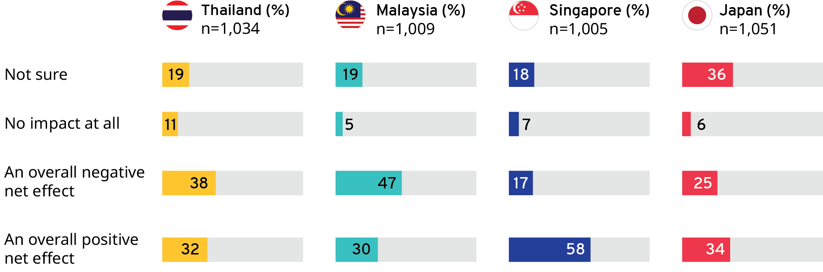
What is the narrative?
Public Attitudes about Migrants Filling Labour Market Shortages
What effect do migrant workers have on the national economy?
Notes:
The facts are often contrary to the narrative we hear in public discourse. We KNOW that migrant workers have a net positive effect on national economies, in both countries of origin and receiving countries, despite the findings on this slide that show a significant proportion of respondents assume that migrant workers have a overall negative effect

Slide 5
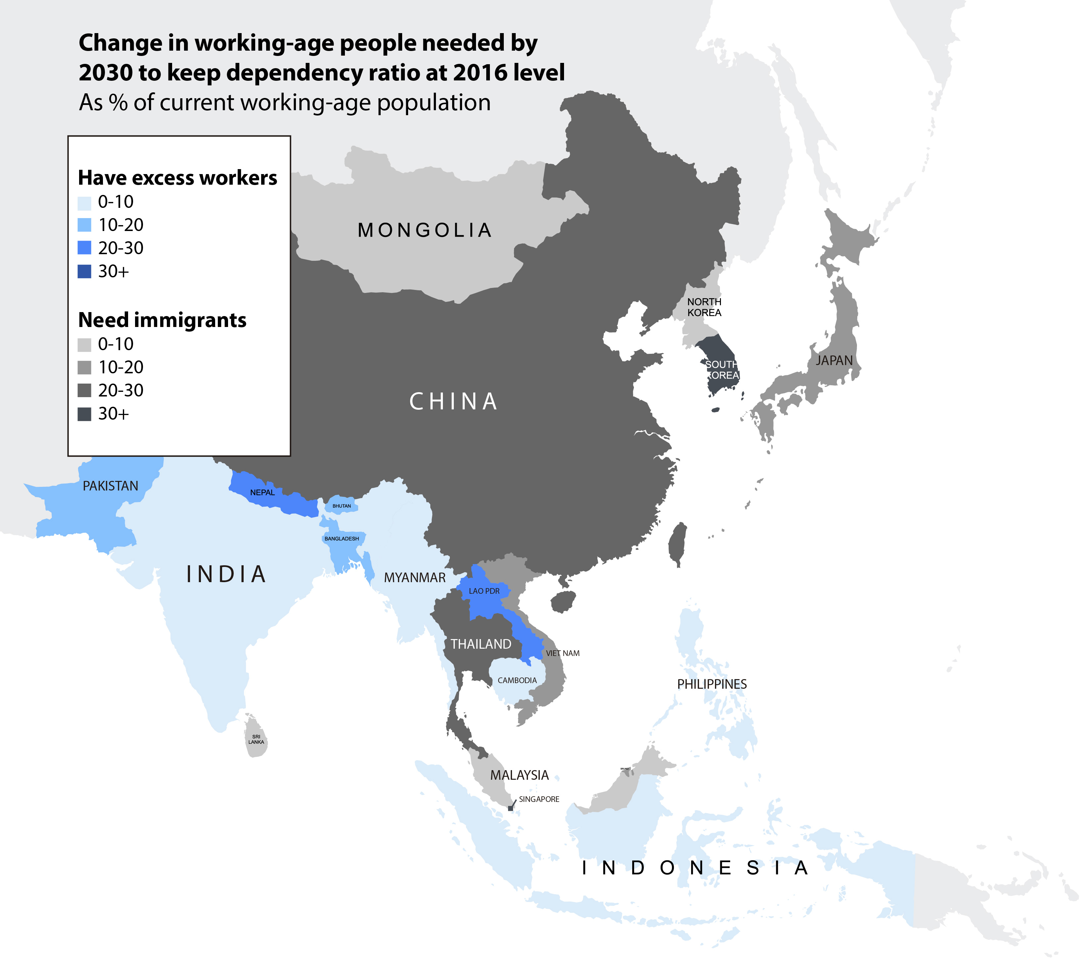
Economist, 2017 data, in UNDP, 2018
Notes:
Population demographics are changing in Asian destination countries:
Dependency ratios are falling (more dependents/ elderly needing care, fewer workers to provide it & to maintain labour forces)
We know: a 10 per cent net increase in manual or “low-skilled” migrant workers may increase Malaysia’s GDP by up to 1.1 per cent (World Bank, 2015).

Slide 6
What is the narrative?
Migrants and Crime: Unfounded Fears
How many people think crime rates are increasing due to migration?
  Over half the respondents in Singapore and Japan
  Over three quarters from Thailand
  A staggering 83 per cent of those surveyed in Malaysia.
However, research shows that an increase of 100,000 migrant workers in Malaysia reduces crimes by 9.9 per cent (Özden, Testaverde, and Wagner, 2015 in World Bank, 2015).
The negative attitudes related to crime are not fact-based.
Notes:
The facts are often contrary to the narrative we hear in public discourse #2
For example, over half of the samples from all countries believed that crime rates increase due to migration, but from other research, we know that increasing the numbers of migrant workers in Malaysia actually led to a reduction in crime.

Slide 7
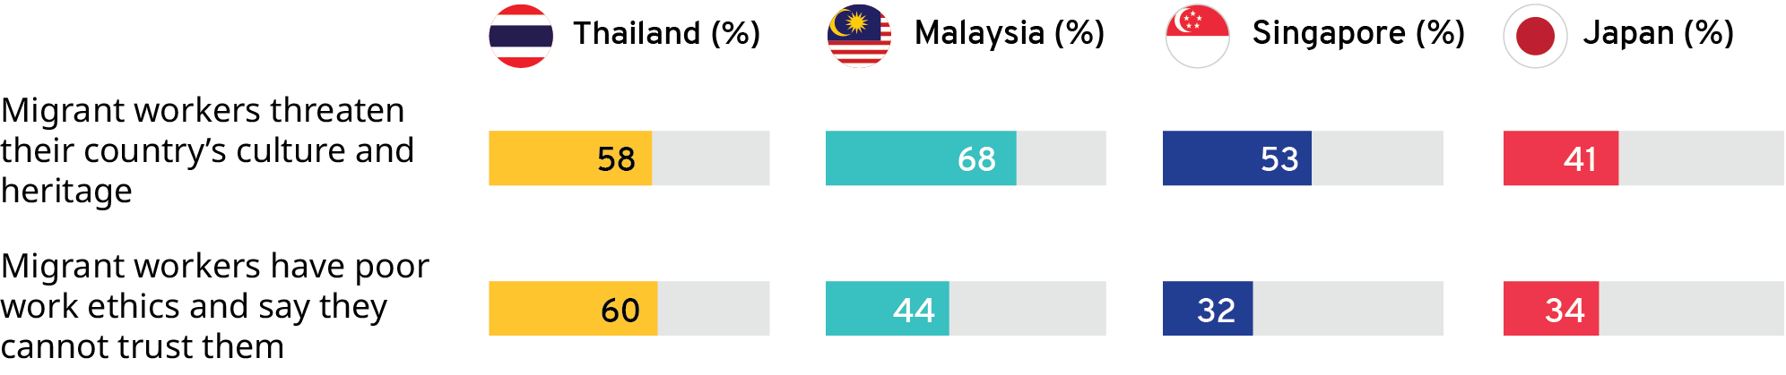
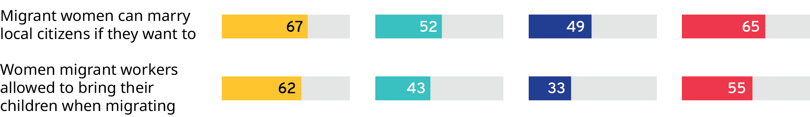
Social Inclusion vs. Social Threats
Higher percentages with respect to women’s issues of social inclusion

Slide 8
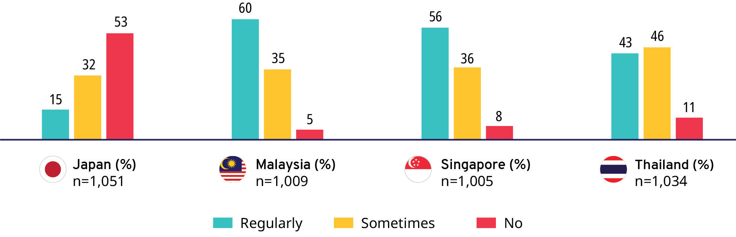
What is going to change this?
Interactions with Migrant Workers
Frequency of Interaction with Migrant Workers
KEY FINDING: The frequency and quality of interaction with migrant workers were the strongest predictor of individuals’ support for migrant workers.
Respondents who reported more frequent and closer interactions with migrant workers had better attitudes towards them (consistent with 2010 findings)
EXCEPT for employers of domestic workers whose attitudes were stable (vis-à-vis 2010) in Singapore but declined in Malaysia and Thailand.
Notes:
While we can only speculate why attitudes towards migrant workers are declining, we can still take action with what we do know. This study confirmed a finding from an earlier version; that the frequency and quality of interaction with migrant workers is the strongest predictor of support for these workers. In this case, we have to programme opportunities for migrant workers and nationals to have these positive interactions.

Slide 9
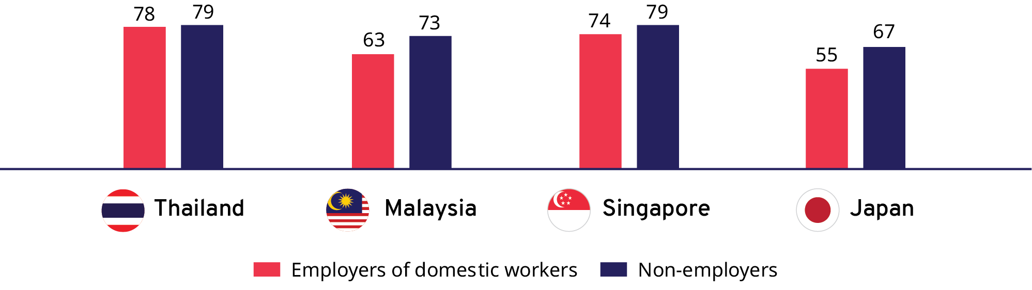
Improving Domestic Work While There is Public Support
Support for improved labour conditions for domestic migrant workers
Notes:
One of the biggest challenges is how we target our work to best encourage opinions to become norms and laws. Knowing, for example, that nearly 80 per cent of respondents in Thailand indicated they would support improved conditions for domestic workers tells us that now is the time to push for legislative reform that better protects domestic workers.

Slide 10
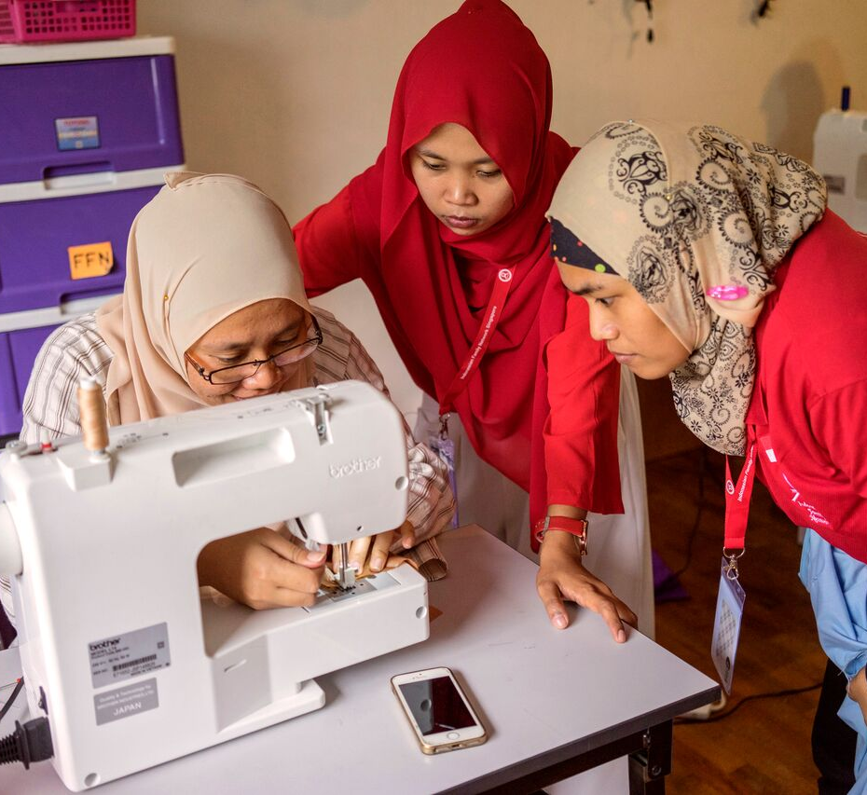
Thank you
Photo: ILO

